Slide 1

PROJECT 4
FACE RECOGNITION WEBSITE
Instructor: TS. Lê Văn Minh
Group members: Trần Minh Thích 17IT028
Trần Đình Nghĩa 17IT020
Đà Nẵng, 13th January in 2019.

Slide 2
Table of contents
Chapter 1
Introduction
Chapter 2
Project research
Chapter 3
Deploy and install
Chapter 4
Conclusion and development direction

Slide 3

Chapter 1 Introduction
Today, along with the development of society, security issues are demanding in every country of the world. The system human recognition system was born with increasing reliability.
The face recognition problem serves strongly in many fields areas of life especially in the areas of high technology required ensure security and confidentiality ...

Slide 4
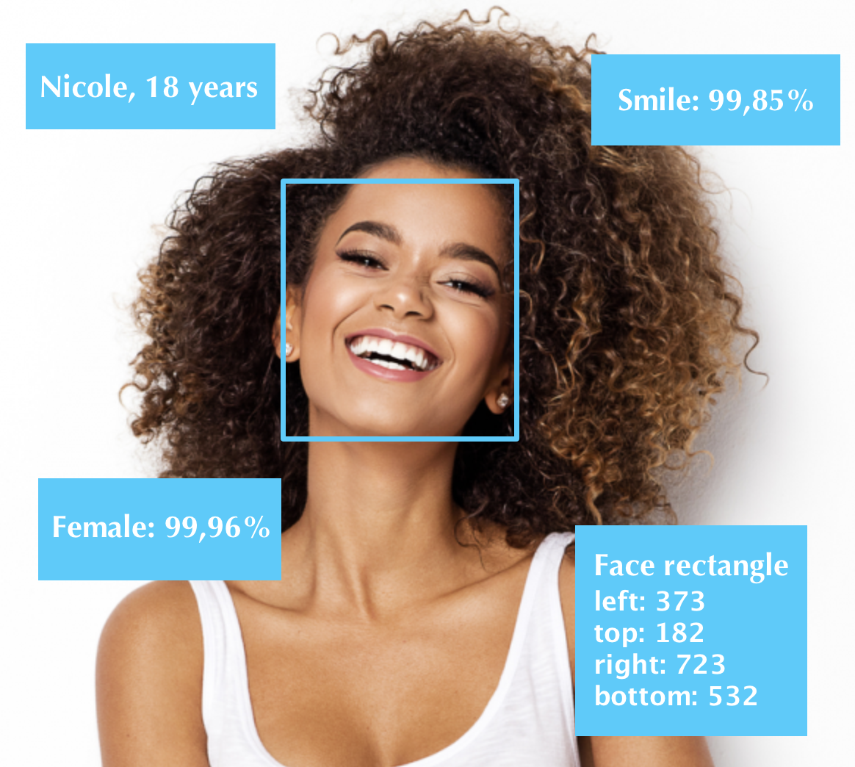
Chapter 1 Introduction
Results towards
A website with a simple, easy-to-use interface.
The website has the ability to detect and identify information of the object in the image.

Slide 5

Chapter 2 Project research
There are two methods
1. The Face API JS library built on Tensorflow
SSD MobileNetV1
Face LandMark
Face Recognition

Slide 6





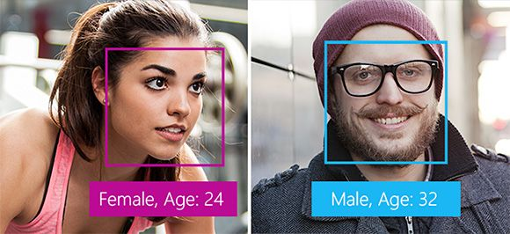
Chapter 2 Project research
2. Microsoft API
Computer Vision API
Emotion API
Video API
Face API

Slide 7
Chapter 2 Project research
These API libraries make it easy for developers to build built and application, user friendly, save effort, more time than technology Deep Learning, ML. However accuracy yet to be comparable with Deep Learning technology.
Face API's Library Tensorflow is completely free, accessible and easier to use than Face API Microsoft so we decided to choose Tensorflow's library to implement this project.

Slide 8
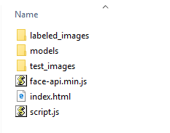
Chapter 3 Deploy and install
Folder structure
Labeled_images: contain the folder of image labels of characters
Models: contain the models can be used in project
Test_images: contain images for testing
Face-api.min.js: the Face API minimize library
Index.html: rendering page
Script.js: custom code for recognizing

Slide 9

Chapter 3 Deploy and install
Deployment
Add 2 files: Index.html for rendering page, Script.js for custom code that we are writing for recognizing
Set up file Index.html and include “face-api.min.js”
In file Script.js, we load models data and upload image

Slide 10
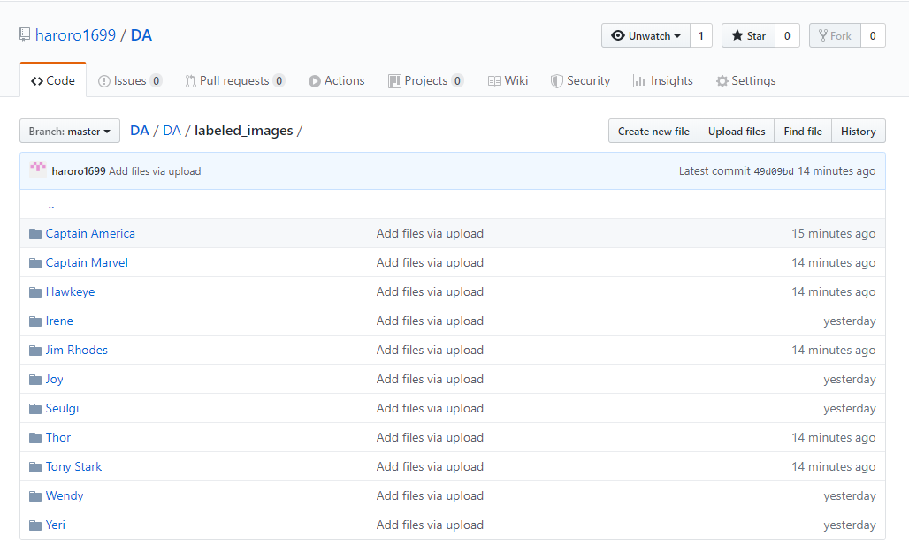
Chapter 3 Deploy and install
Receive a full description for all Faces from an Input Image. There description will be our reference data
We have some example images for our subjects available, we first fetch the images from an url and create HTML image elements from their data buffers using ”faceapi.fetchImage”.

Slide 11
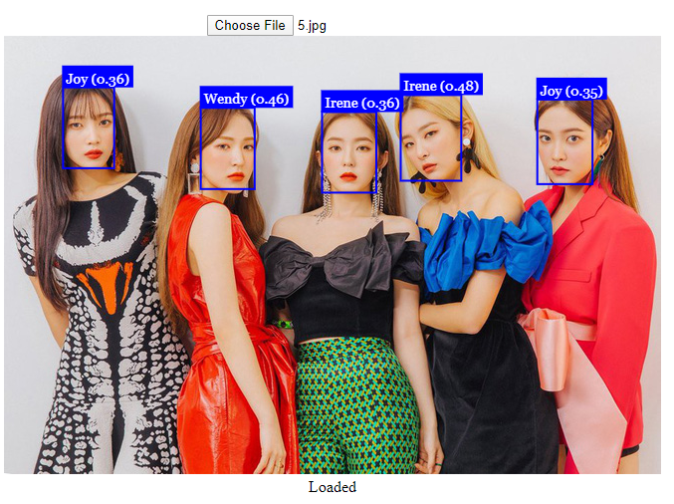

Chapter 3 Deploy and install
For each fetched image, we receive a full description for face as Input image. Everything that remains to be done is to match the face descriptors of the detected faces from our input image to our reference data
Finally we can draw the bounding boxes together with their labels into a canvas to display the results

Slide 12



Chapter 3 Deploy and install
Tool and environment
Visual Studio Code
LiveServer
Google Chrome

Slide 13
Chapter 4 Conclusion and development direction
The final product we have perfected the capable website distinguish and recognize each person's face, using the library Tensorflow's Face API.
Advantages:
Direct photo transfer function is already stored in the computer or phone.
User-friendly interface, easy to use.
Relatively accurate identification of objects in the image.
Limit:
The interface is not really optimal.
Still quite a few features.
Has not added the function to count the number of people in the picture image
The loading time is not really fast.
Need internet connection to operate.

Slide 14
Development direction
Upgrade the website interface.
Build function direct image transmission from URL.
Complete data, identity recognition function, attendance.

Slide 15
Thank You
FOR THE ATTENTION

